Slide 1
An Interface for Analyzing Avatar Data from 3D Scanners

Slide 2
Background
In collaboration with Dr. Steven Heymsfield and his research team at Pennington Biomedical Research Center
Their Goal
Analyze connection between body composition and obesity related health concerns
Collect data digitally rather than by hand
Our Goal
Create a graphical user interface (GUI) for digital data collection and analysis

Slide 3
Key Terms
Digital Anthropometry (DA)- methods of measurement using 3D
scanning devices
Conventional Anthropometry (CA) - methods of measurement using
measuring tape and calipers
Repository Variable- MATLAB variable that stores information that
remains constant across multiple user session

Slide 4
Goals of the GUI
Tab One – User entry of manual measurement data (CA data)
Tab Two – Load avatar data; display, segment, and calculate digital measurement
data (DA data)
Tab Three – Displays relative error of DA data compared to CA data, per subject
Tab Four – Statistical analysis on accuracy of DA data, overall

Slide 5
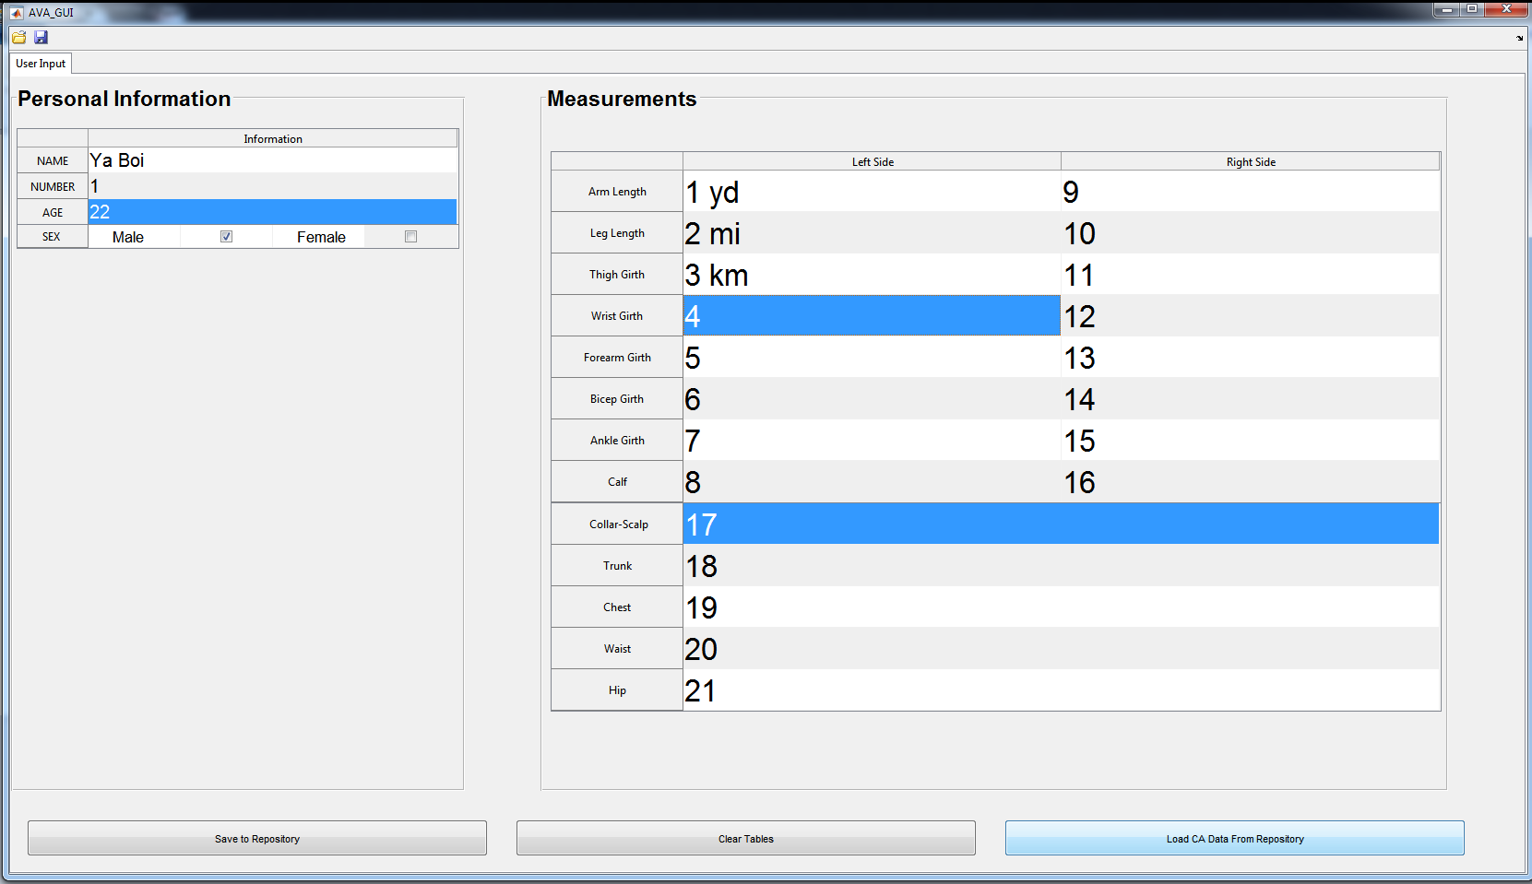
Tab 1 Goals
Create a user friendly way for researchers to input CA data
Be able to recall this information for later analysis of scanner measurements.
Figure 1: User input tab input functionality

Slide 6
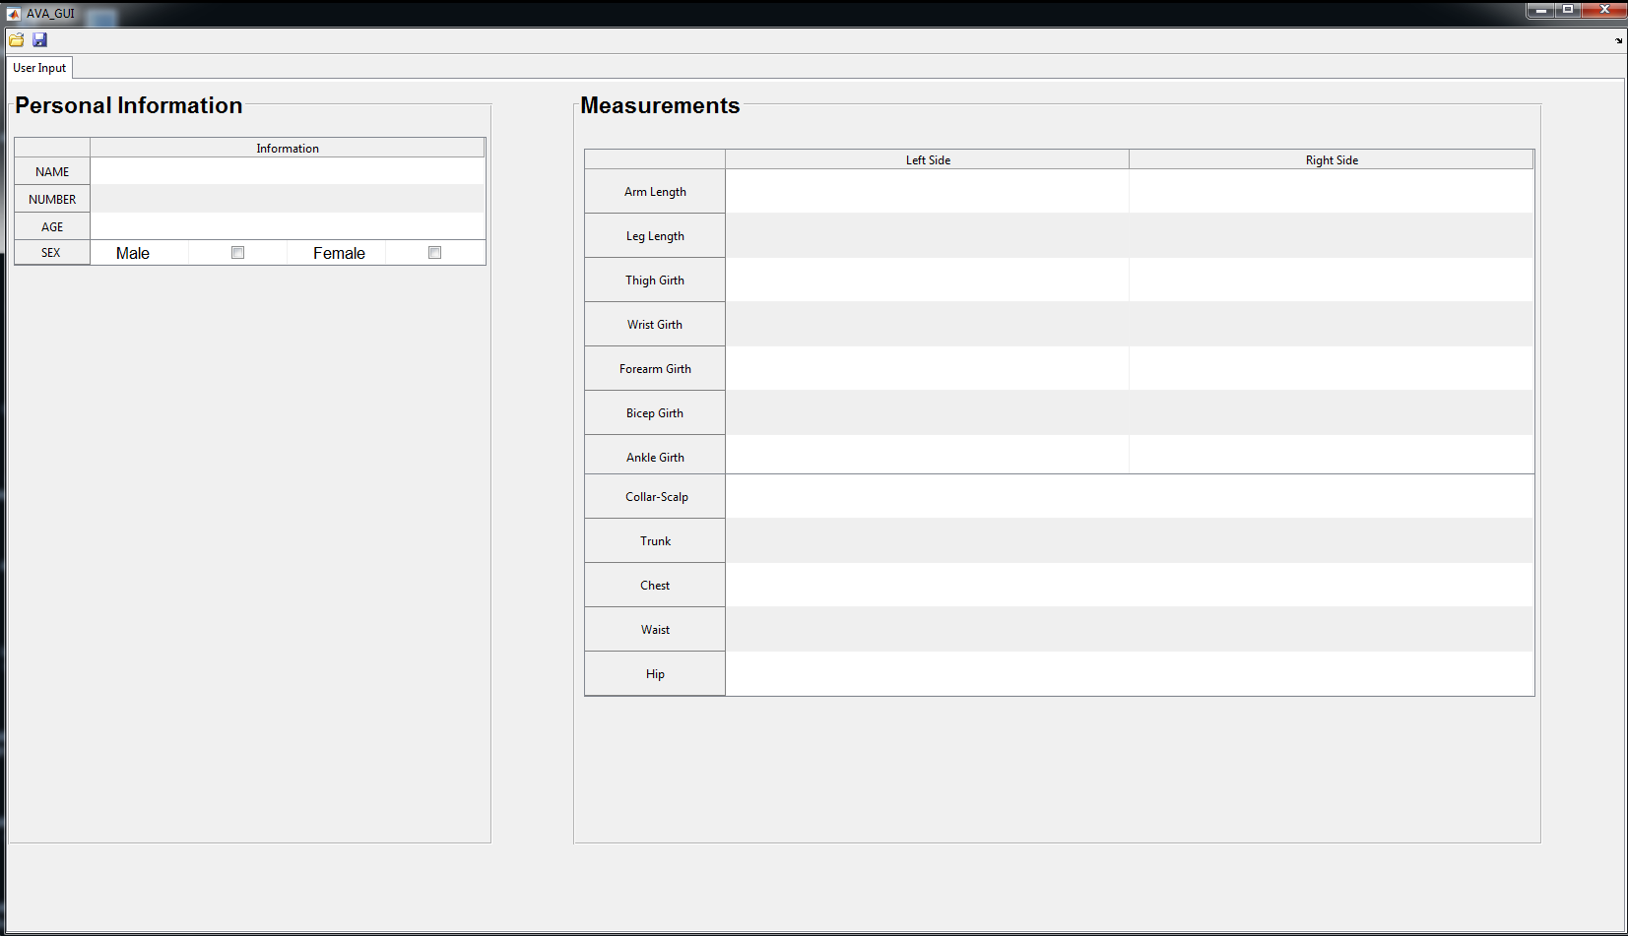
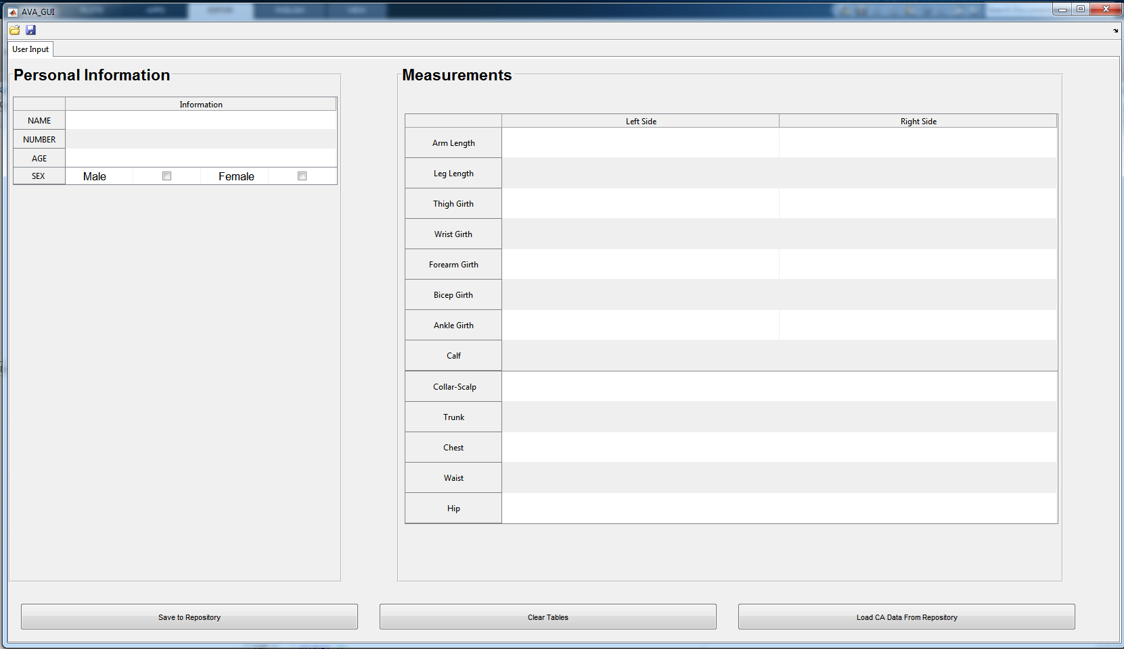
Tab 1
Figure 2: Tab I as of 10.28.17
Figure 3: Tab I as of 11.19.17

Slide 7
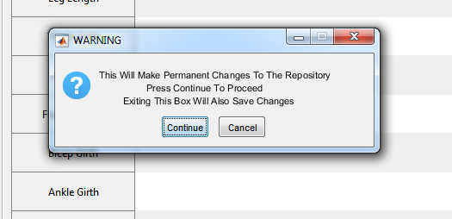
Tab 1 Points of Interest (The Three Buttons)
Save to Repository
Figure 4: Tab 1 “Save to Repository” push button
Figure 5: “Save to Repository” push button warning dialog box

Slide 8
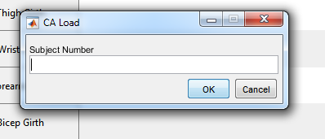
Clear
Load CA Data
Figure 6: Tab I “Clear Tables” push button
Figure 7: Tab I “Load CA Data From Repository” push button
Figure 8: Tab I Subject number for CA Load dialog box

Slide 9
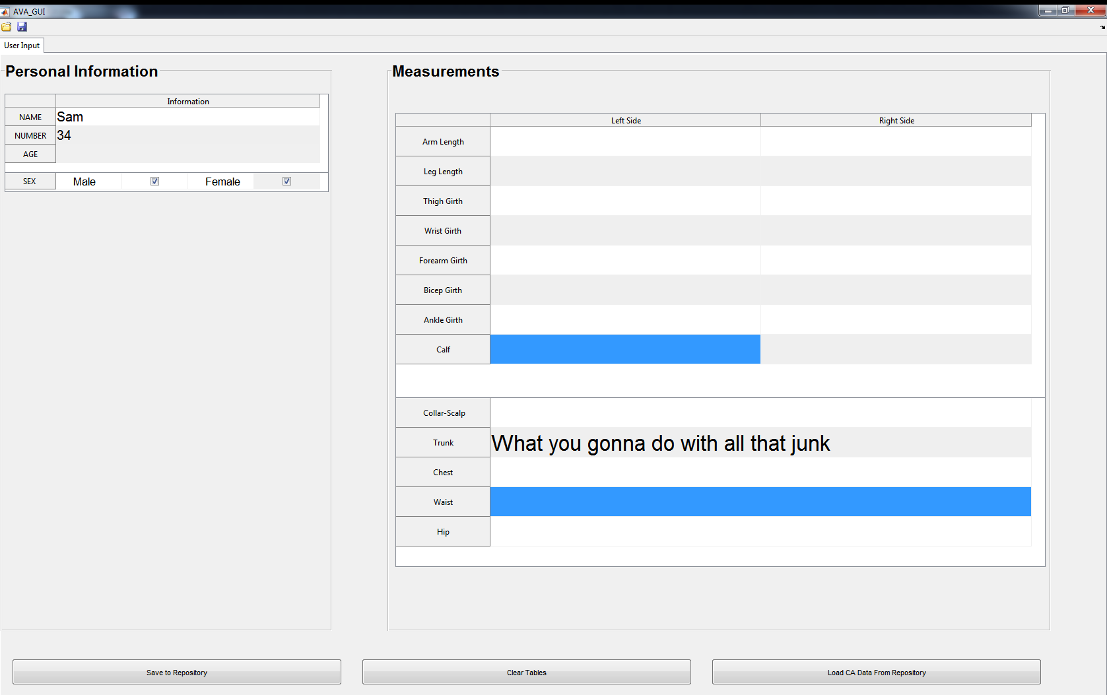
Tab 1 Needed Improvements
When the GUI is on a differently scaled monitor, gaps (or overlaps) between the different tables can be found.
Error messages need to be shown for
Nonsensical inputs.
Figure 9: Tab I monitor scaling error

Slide 10
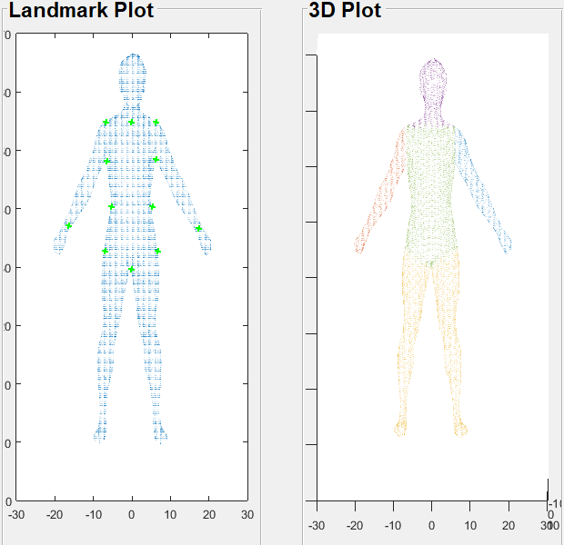
Tab 2 Display of Avatar
Figure 10: 3D Avatar
Figure 11: Plots of Avatar in GUI

Slide 11
Tab Two DA Measurements
Tab Two Functionality
Load and display avatar
Locate Landmarks and segment avatar
Calculate DA measurements
Add new row into Repository
Figure 12: DA Measurements

Slide 12
Tab 3
DA Data Accuracy Per Subject
Functionality –
Load a subject’s CA data from Tab 1
Load that same subject's DA data, calculated in Tab 2, from the repository
Calculate and display relative error of each DA measurement per device with respect to CA measurement—our point of reference

Slide 13
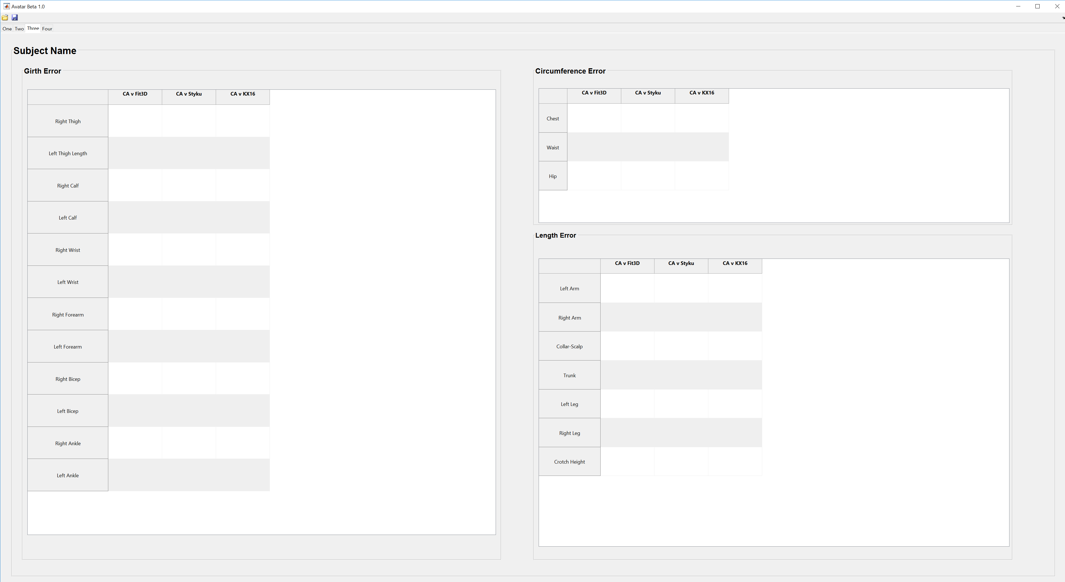
Figure 13: Tab III as of 11.27.17

Slide 14
The Template for Tab IV

Slide 15
Progression of Tab IV

Slide 16
Final Template

Slide 17
Difficulties

Slide 18
Conclusion
Operational tables that will read loadable data
Analytical Tabs
Have a working repository with callback funcationality

Slide 19
Future Goals of the Project
Minimize errors
Cross compare multiple scanners
Currently have 4 machines
Measurements as features of estimation for potential health risks
Bone Density, Body Fat Percentages, Blood Pressure

