Slide 1
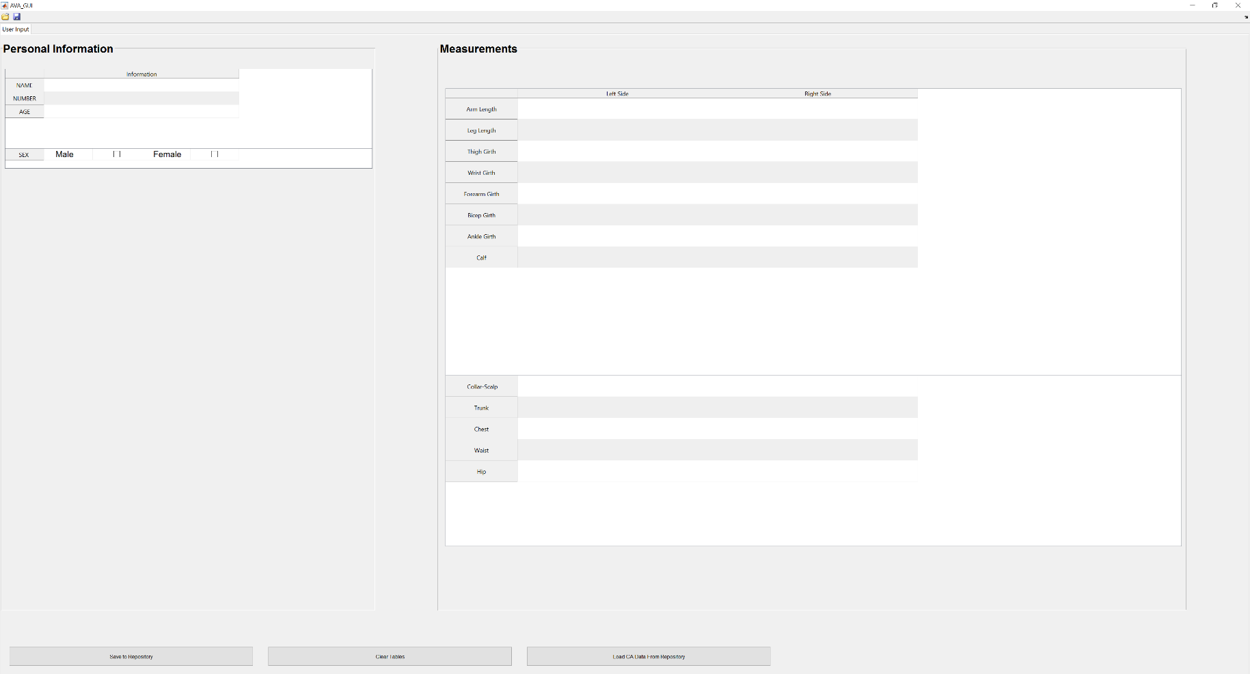
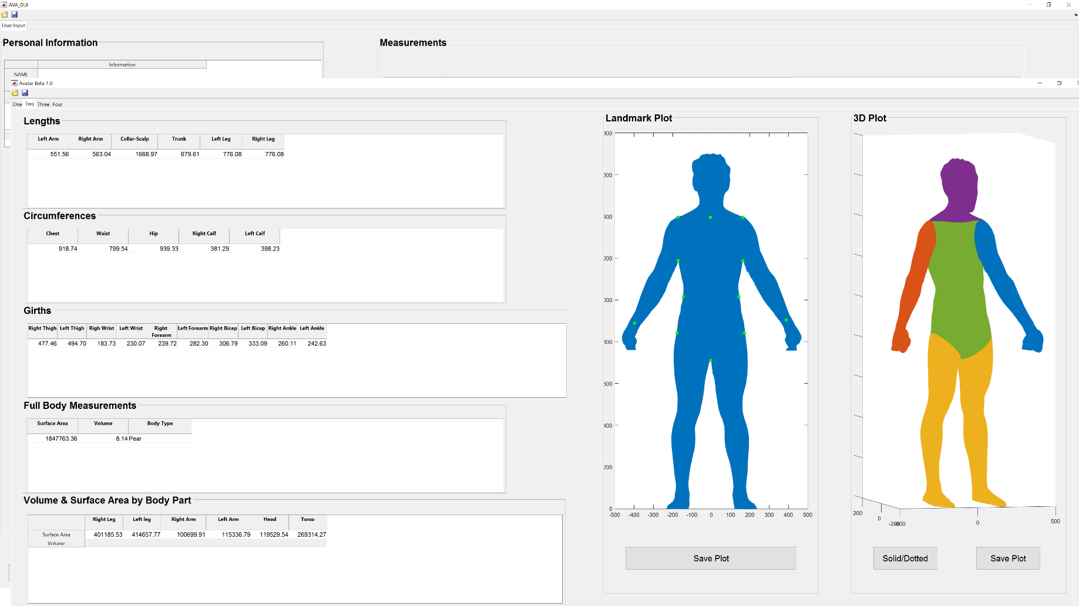
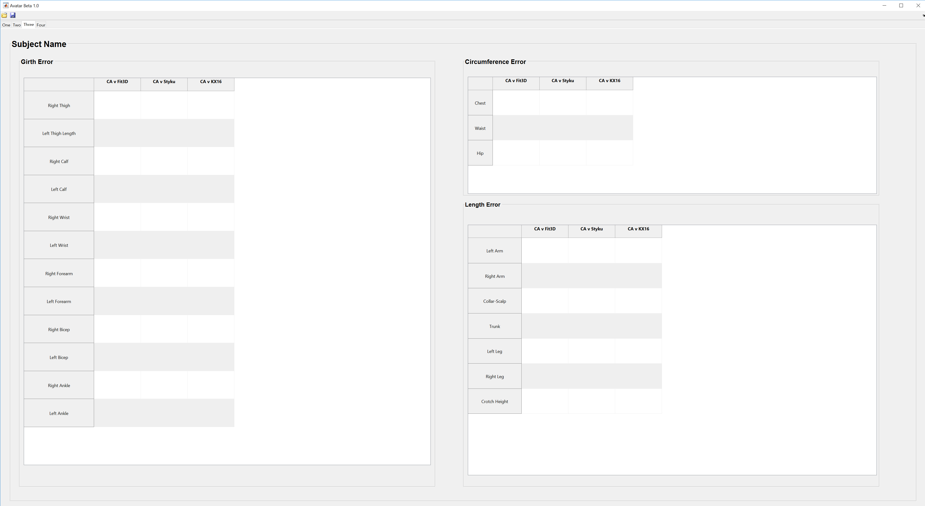
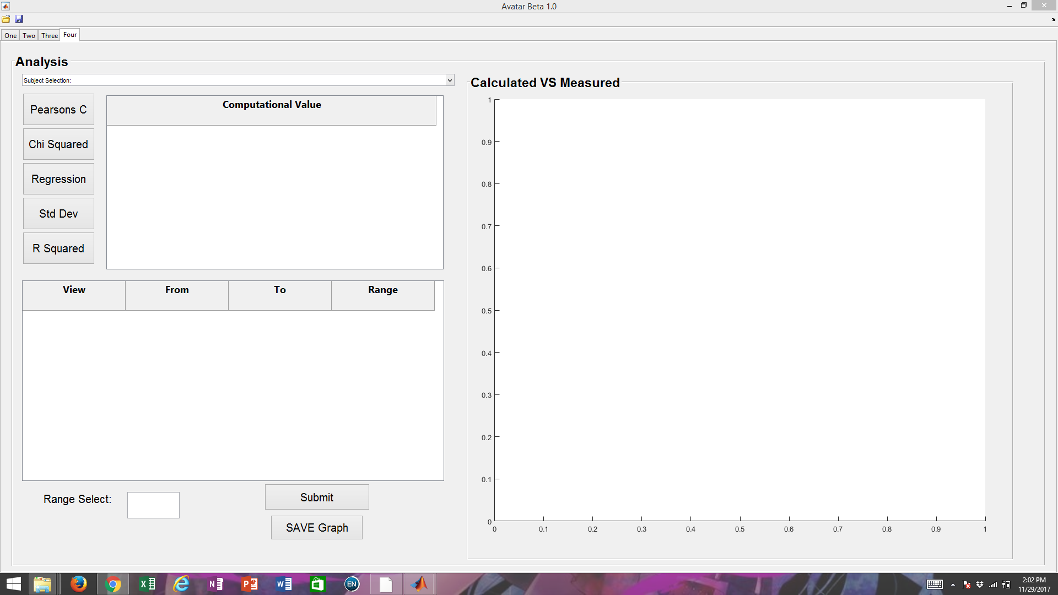
An Interface for Analyzing Avatar Data from 3D Scanners
Kyle Wedge, Benjamin Mosery, Ricky Tran, Margrethe Sylvester, Sima Sobhiyeh, Ryan Leigon, Mary Wang
Louisiana State University Math Consultation Clinic, Supervised by Dr. Wolenski
Introduction
GUI Implementation
Future work
Dr. Steven Heymsfield and his team in the Metabolism & Body Composition Laboratory at Pennington Biomedical Research Center collaborated with our group in their work towards the goal of establishing a connection between obesity related health concerns and body composition. In order to expedite the process of collecting subject body measurements, the team has looked to 3D scanning. They came to our group for the development of an easy-to-use graphical user interface (GUI) to calculate body measurements using scan data from PBRC’s three scanning devices and compare the accuracy of these digital measurements with their reference point — measurements acquired by conventional measuring techniques. Our team created the GUI in programming software Matrix Laboratory (MATLAB).
The GUI consists of four tabs: User Input, DA Data Calculation, DA Data Accuracy - Subject, and DA Data Accuracy – Overall.
Further development of the GUI will be completed by the Math Consultation Clinic to:
minimize DA data errors
accommodate the use of four or more scanners
improve interface aesthetics
integrate forgiveness into interface design to allow researchers to prevent and recover from user errors
The clinic and Dr. Heymsfield’s team are looking to continue collaboration on the topic of the relation between body composition and obesity related health concerns with the development of an additional GUI that will allow the researchers to compare subject scan data with subject internal physiology, like cardiovascular and endocrine health.
Figure 1:
Tab 1 – User Input
The first tab comprises of organized tables for the researcher to input the personal information of a subject along with the subject’s CA data. Push buttons within the tab can save this information to the repository and also load previously entered CA data.
Figure 2:
Tab 2 – DA Data Calculation
The second tab loads the subject's .OBJ file and displays a 2-Dimensional landmark plot and a 3-Dimensional Segmentation. DA measurements are calculated and displayed by body part in respective tables.
Key terms
Acknowledgements/References
avatar data – the output of a 3D human scanning device;
each Pennington scanner outputs an .OBJ file, a geometry definition file format which represents 3D geometry
digital anthropometry – methods of measurement using 3D scanning devices
digital anthropometric data (DA data) refers to the set of 31 bodily measurements calculated by our GUI, given an .OBJ file, including chest circumference, trunk length, and subject volume
conventional anthropometry – methods of measurement using measuring tape and calipers
conventional anthropometric data (CA data) refers to the set of measurements taken directly from subjects by Pennington researchers
repository variable – for our project, a MATLAB formatted data file that stores each subject’s CA data, DA data, and avatar data; remains constant across multiple user sessions
We would like to thank Dr. Peter Wolenski for developing The Math Consultation Clinic to aid undergraduate research efforts and for his support in our work. We would also like thank Dr. Steven Heymsfield and the team at Pennington for providing us with this enlightening research opportunity.
References:
Jayaratne YSN, Zwahlen RA. Application of Digital Anthropometry for Craniofacial Assessment. Craniomaxillofacial Trauma & Reconstruction. 2014;7(2):101-107. doi:10.1055/s-0034-1371540.
Reddy M. MartinReddy.net. http://www.martinreddy.net/gfx/3d/OBJ.spec. Accessed November 27, 2017.
Figure 3:
Tab 3 – DA Data Accuracy – Subject
The third tab displays the relative error of an individual subject’s DA data, called from the repository, compared to her CA data, entered in Tab 1.
Figure 4:
Tab 4 – DA Data Accuracy – Overall
The fourth tab allows the researcher to select multiple ranges of subjects to perform various analyses for comparative data and to visualize the amount of error that still exists within her function.

